Slide 1
CANTEEN MANAGEMENT SYSTEM
BY
B117038 PULI KIRAN
B117043 RUPESH KRISHNA JHA
B117047 SAIYAN DE BHOWMICK
B117052 SUMEET SAGAR LENKA
B117054 SWETA BEHRA

Slide 2
Canteen management
The project CANTEEN MANAGEMENT SYSTEM includes some facilities of customer’s and products search , display , modification , delete etc . This software searches the client data which is store in the record and then gives permission to place the order by the customer
The software used for small scale canteens which have limited customers and products and wants to maintain the records

Slide 3
Concepts used
File handling
Classes
Inline functions
Encapsulation

Slide 4
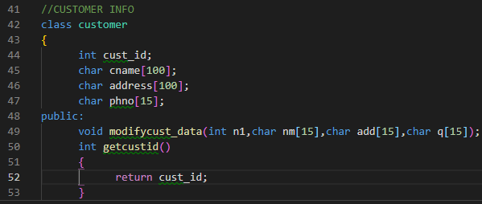
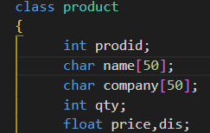
Classes

Slide 5
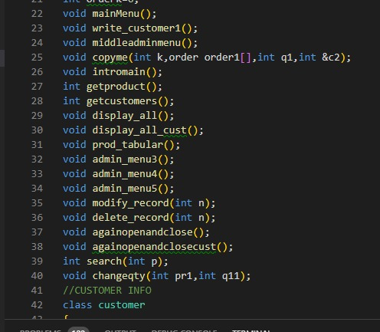
Functions used

Slide 6



File handling

Slide 7
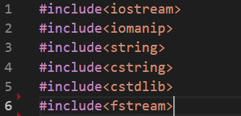
Header files

Slide 8
THANK YOU

